Slide 1
The Jungle Game
COMP2021 Object-Oriented Programming (Fall 2018)
Project Group 10
Cheung Ka Ho(17047931d)
Ngan Ting Cheuk (17061434d)
Yan Ho Wang (17057122d)
Yau Yuet Man (17056093d)

Slide 2
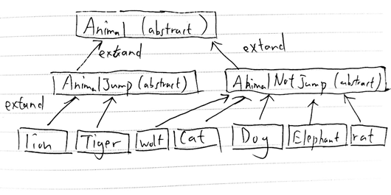
Design

Slide 3
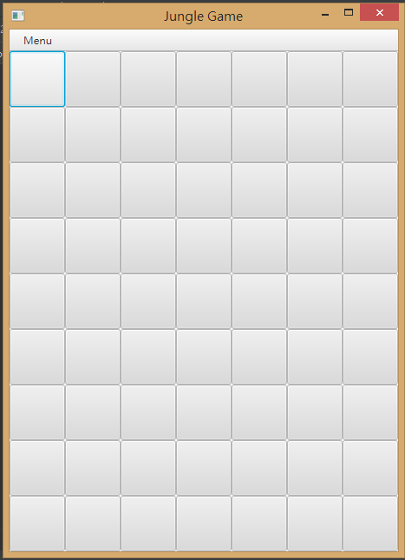
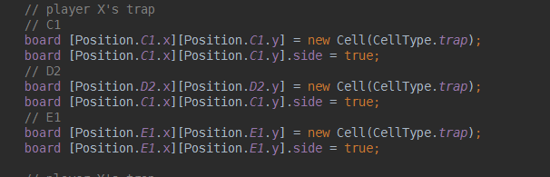
The grid
Every cell of the grid is an object
Storing ”side” and “animal” and “cellType”
Four types of cell (normal, river, trap, den)

Slide 4
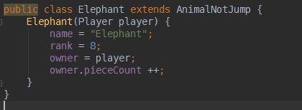
Each Animal Class:
Each animal class incldes information of it’s name, ranking , it’s owner.

Slide 5
How OOP inprove code reusability & scalability Example: “Animal” class
Abstraction
Design level - Focusing on the what the “Animal” class should contain and reduce unnecessary attributes(i.e we only concern the name, rank, owner in class “Animal”).
Implementation level - Using abstract class “Animal”, we can add necessary attributes or methods by extending it in the future (reusability & scalability↑).

Slide 6
How OOP inprove code reusability & scalability Example: “Animal” class
Inheritance
Design level - Animals share most of the attributes.
Implementation level - Subclass of “Animal”,e.g. class “Wolf” “extends” its superclass “Animal ”each time we create a new subclass, we can inherit the same attributes (reusability & scalability ↑).

Slide 7
How OOP inprove code reusability & scalability Example: “Animal” class
Polymorphism
Design level - Some animals may have different attributes, rat can swim while some can jump rivers(lion and tiger).
Implementation level - Subclass of “Animal”,e.g. class “Rat” contains “canSwim” method while “Lion” and “Tiger” overrides the “move” method in “Animal” as they have different pattern of movements(i.e jump rivers).
Whenever we create new type of animal, they can have different movement (reusability & scalability ↑).

Slide 8
How OOP inprove code reusability & scalability Example: “Board” class
Encapsulation
Design level - A board is made up of 9x7 cells(Has-A relationship)
Implementation level -
Inner class “Cell” in “Board” V.S -A separate class “Cell”.
Whenever we have another program want to use the “Board” class, we do not need to import another “Cell” since “Cell” is encapsulated by “Board” (reusability & scalability ↑).

Slide 9
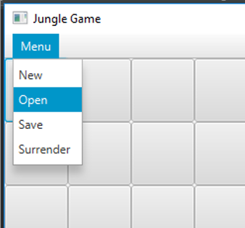
Initiation
-Chose to add New game
-Or Open a saved game

Slide 10
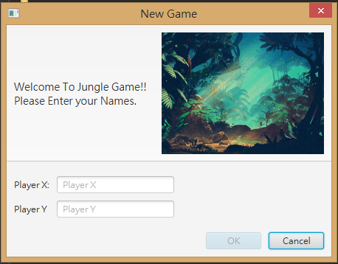
New game
Input player Xs’ and Player Ys’ names

Slide 11
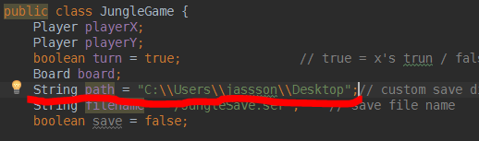

Open a saved game
Set your own directory (command mode only)
Overide the previous file if you save two games in the sam directory
No path : “save” (Save to game directory / path opened from)
Full path / relative path : “save, C://Users/” (Save / Load from exact path)
Informal path : “save, C://Users ” (Path without “/” at the end of string)

Slide 12
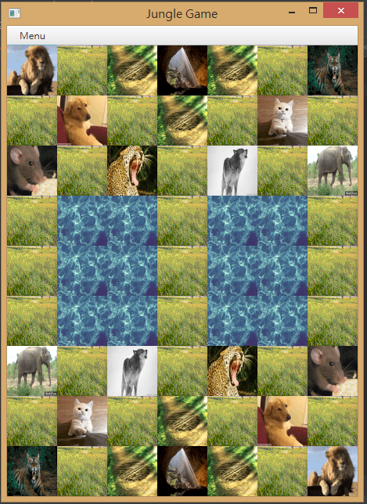
Game Start !
game initializes, ready to strat or resume

Slide 13
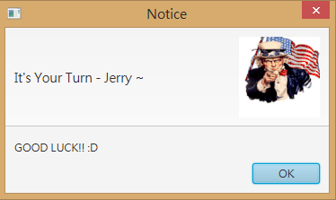
Looping each side
Handle the player turns until one wins

Slide 14
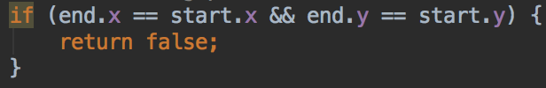
Valid move check
10 checks in total
1st check : Check whether the starting position is same as the ending position
2nd check: Check whether the starting position has a piece

Slide 15
Valid move check
3rd check: Check whether the piece in the starting position is owned by the player who move it?
4th check: Check whether a piece move in a correct way (Not diagonally for all animals)
Check lion and tiger move according to the method overridden in the “AnimalJump” class.
Can Jump over river (& no rat in between the moving path)
Check all other animals move according to the method overridden in “AnimalNotJump” class.
Cannot Jump over river

Slide 16
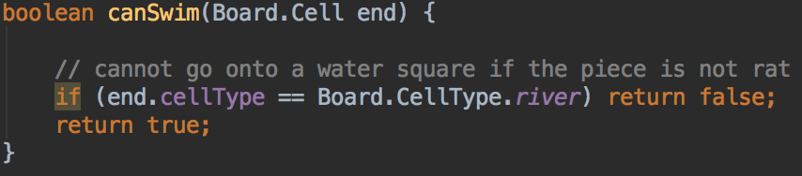
Valid move check
5th check: Check whether the piece can go onto water square
Check rat move according to the method overridden in the “Rat” class
Can go onto water square
Check all other animals move according to the method defined in the “Animal” class
Cannot go onto water square

Slide 17
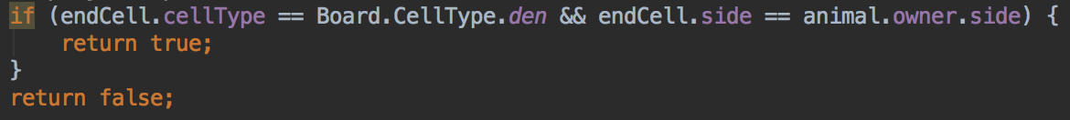
Valid move check
6th check: Check whether the player move his/her pieces to his/her own den
7th check: Check whether the ending position has a piece
If there is no piece in the ending position, it is a valid movement to an empty cell
If there is piece in the ending position, continue the checking

Slide 18
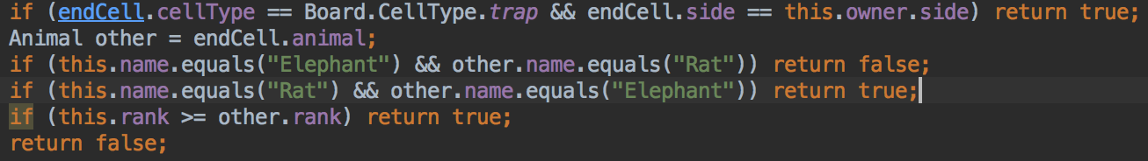
Valid move check
8th check: Check whether the piece in the ending position is owned by the opponents?
9th check: Check whether the a piece is able to capture another piece? (Compare their rank)
A piece can capture any opponent’s pieces in own trap
Elephant cannot capture rat
Rat can capture elephant

Slide 19
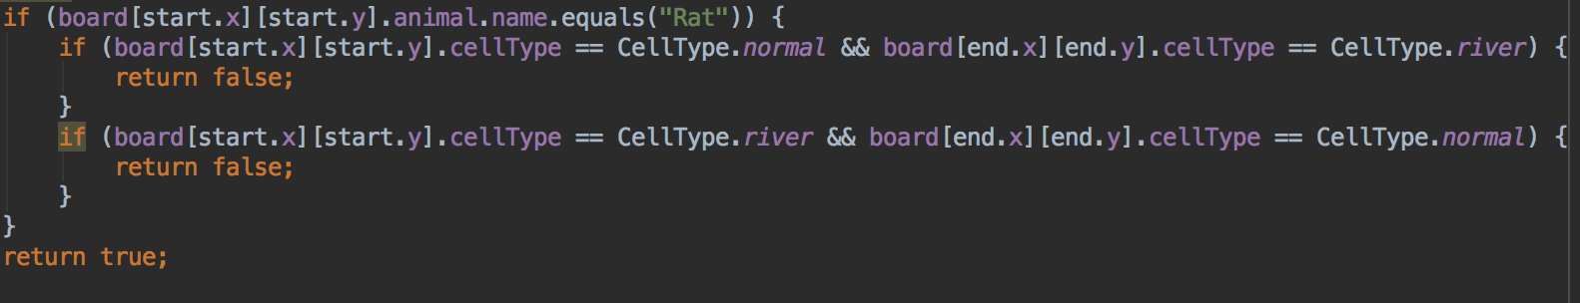
Valid move check
10th check: Check whether a rat try to capture animal from land to water square (or from water square to land)
Only checked when the piece to move is a rat

Slide 20
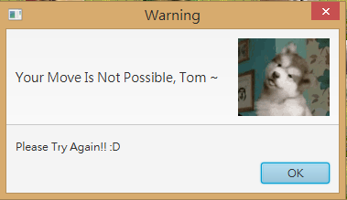
Valid move check
If the move is invalid, the player need to input again
If the move is valid, the program will check whether any win condition is met
If a piece move to an empty cell, check whether the piece move to opponent’s den
If a piece capture an opponent’s piece, check whether all opponent’s piece have been captured

Slide 21
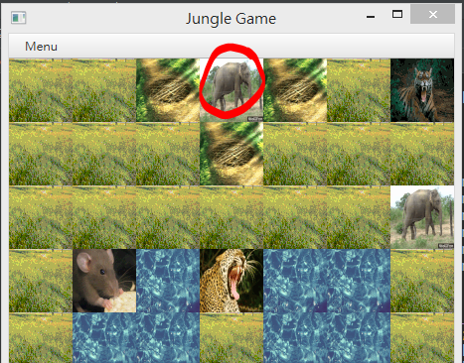
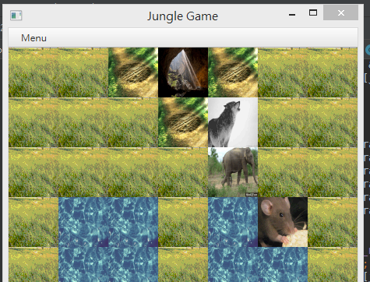
The game ends if...
- move to opponent’s den -Or all opponent’s have been captured

Slide 22

Victory
1st win condition: move to opponent’s den
2nd win condition: all opponent’s pieces have been captured

Slide 23
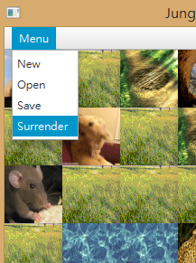
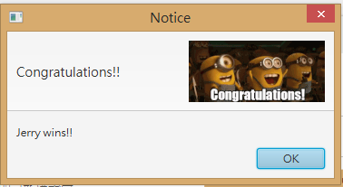
Surrender
-The game ends immediately
-The other side will win the game
->

Slide 24
Q&A

